Slide 1

Project:
Web-Based Sunglasses Recommendation Hub

Slide 2

Concept: Sunn.e
An online sunglasses recommendation website
Linked to online sunglasses retailers
Facial recognition and recommendation algorithms
A fun and simple place to start looking for stylish eyewear

Slide 3
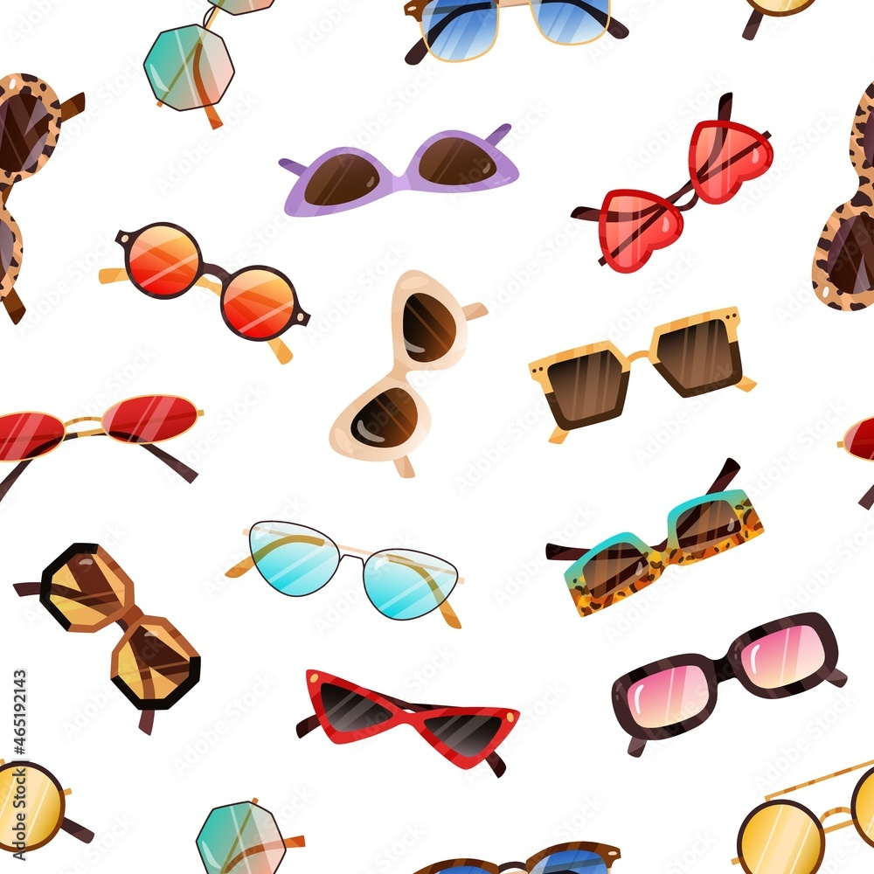
Use and Audience
Targeted for
online-shoppers
people who live remotely (no access to in person retail)
self-image conscious consumers
Used for
finding a style that suits the user
connecting that user with a retailer that supplies it

Slide 4
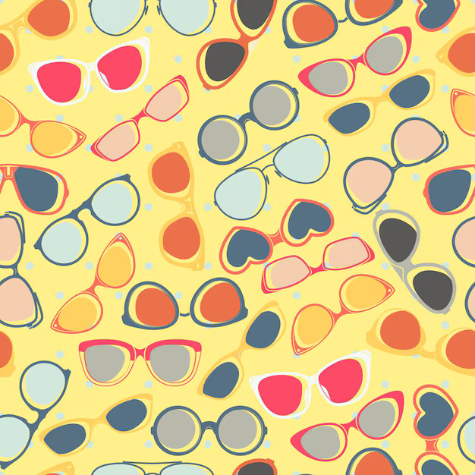
Market Research
Some Online Glasses retailers have augmented reality glasses software.
They allow you to virtually try on glasses
A recommendation solution is not implemented though
There is also some disagreement on ways to recommend glasses
Based on facial shape, nose-eye distance or just personal style

Slide 5
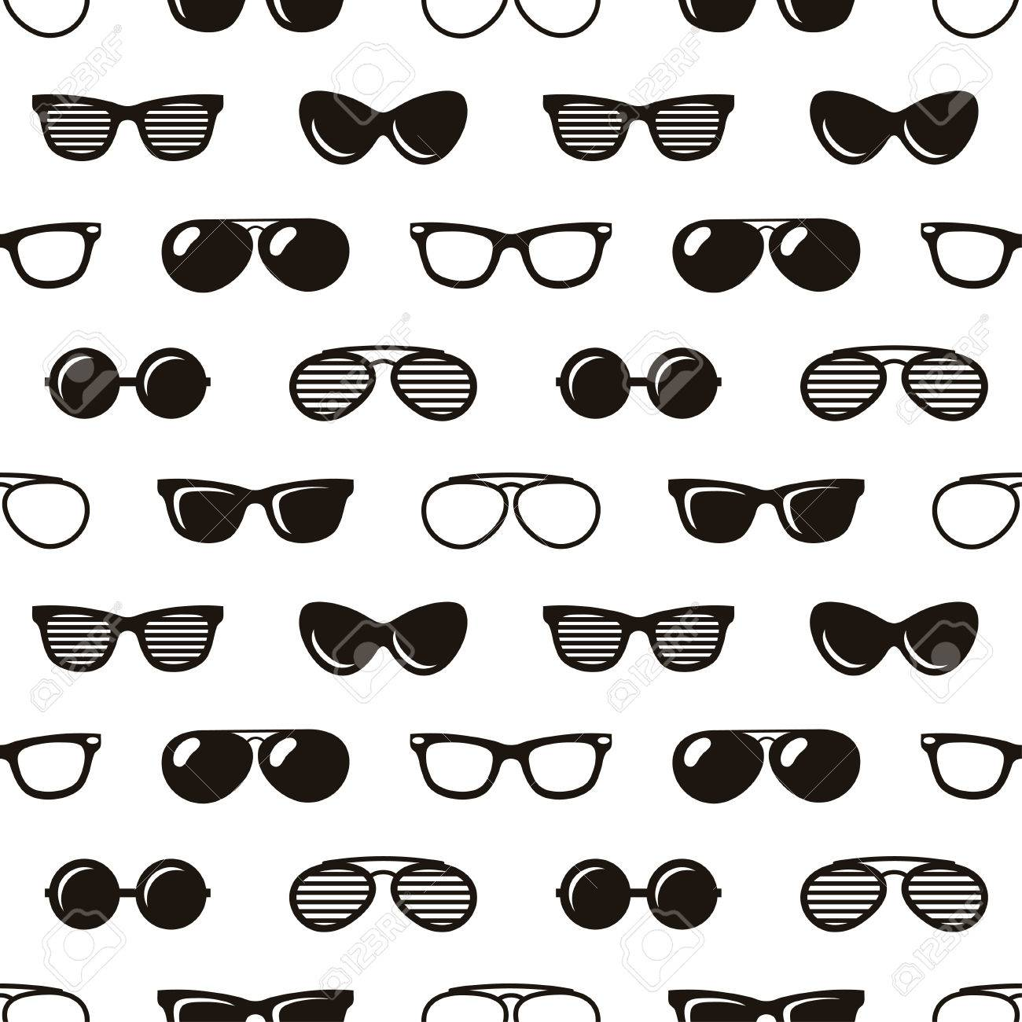
Issues and Considerations
Disagreements on Glasses recommendation methods
We will be working mainly towards personal style
Facial reading can be inaccurate depending on available data
We build the model with low accuracy but give a variety of recommendations each time. The top three generated.
A guide on how to take a proper picture for our algorithm will be available
Frame availability
The site will be outfitted with various general designs
We will also reach out to retailers to partner with and use their stock to funnel customers to them for a profit.

Slide 6
Development Plan
Research and Conceptualisation
Design and Development
Testing and Deployment
Given our Project is a web application, we will follow a simple Iterative SDLC

Slide 7
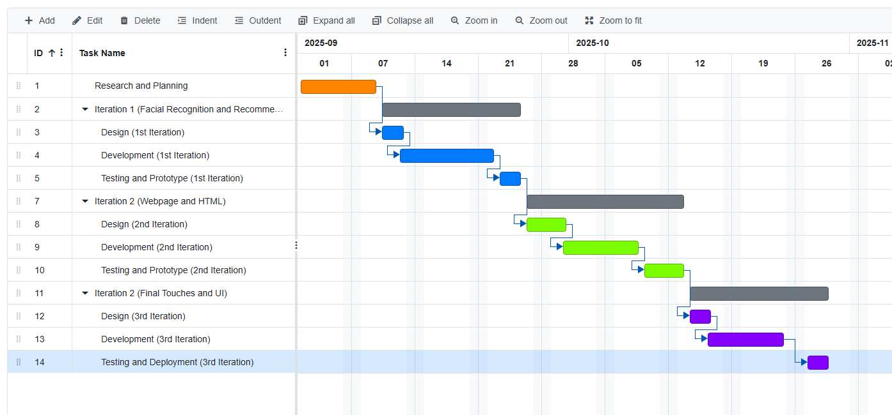
Gantt Chart (Iterative SDLC)

Slide 8
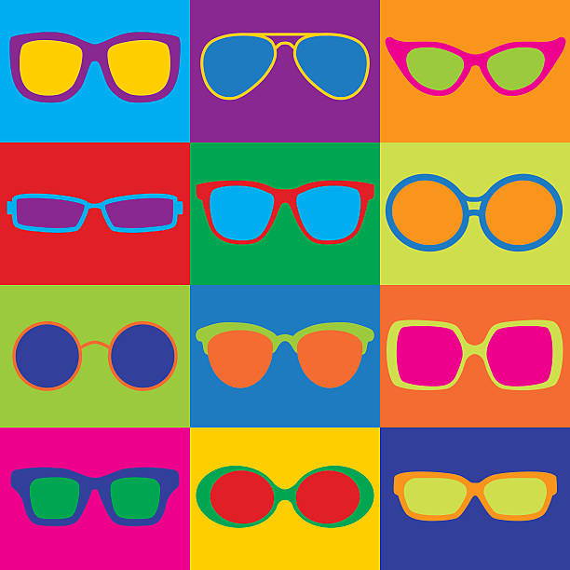
Thanks for listening

